Slide 1
Game Design
Workshop #1
STANFORD | CODE IN PLACE
With Guest Speaker WattDesigns
Hosted by Ngoc

Slide 2
TABLE OF CONTENTS
01.
02.
03.
WHY GAMES?
GUEST SPEAKER
CLOSING STATEMENT
Game development & play experiences
Meet WattDesigns
What’s next?

Slide 3
01.
Why Games?
Game development & play experiences

Slide 4
Type your favorite game in the chat!

Slide 5
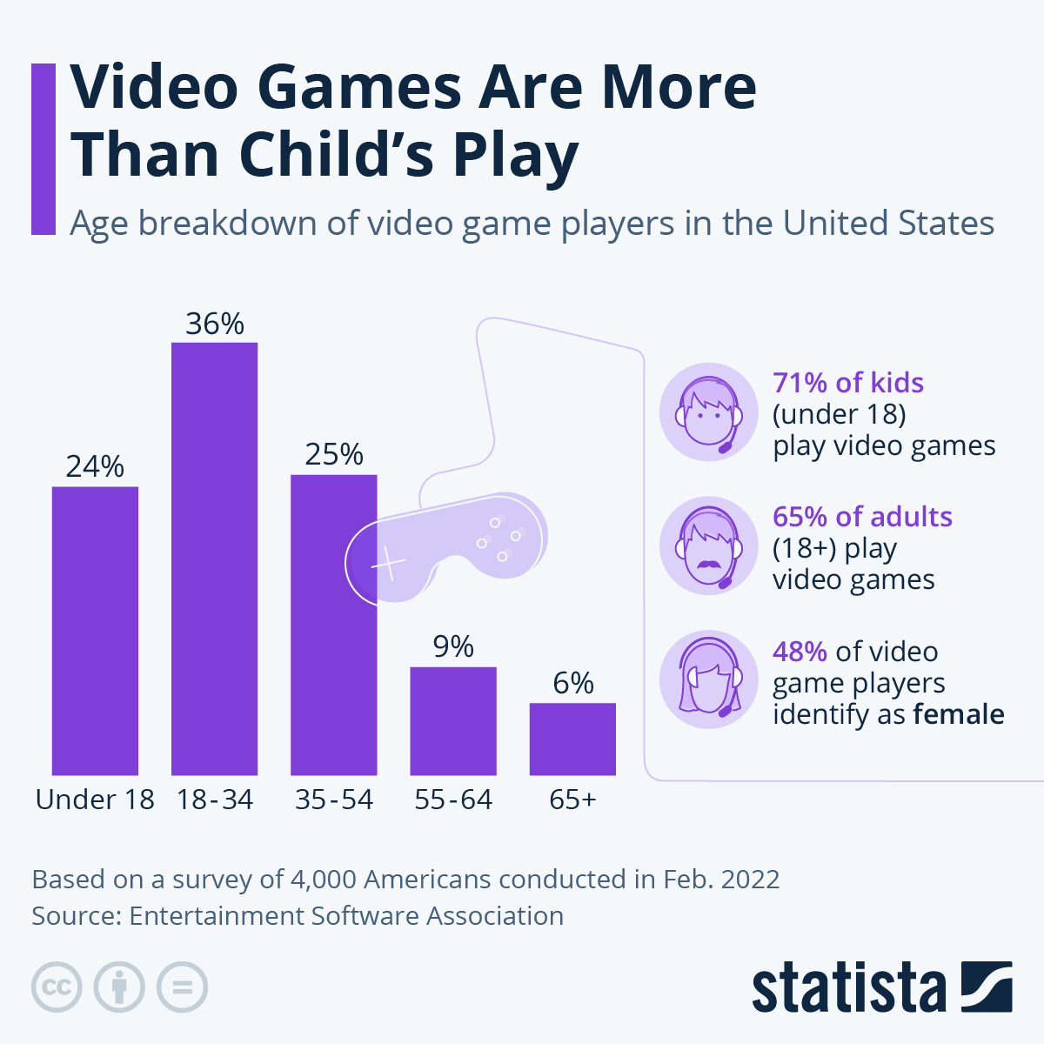
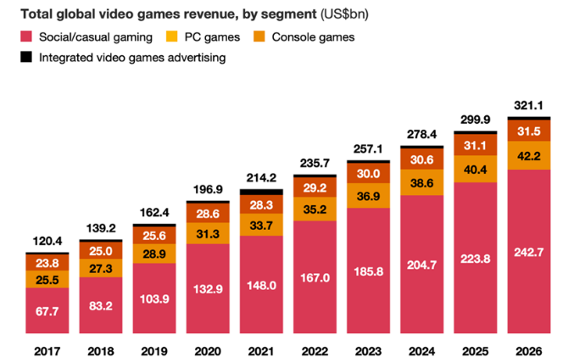
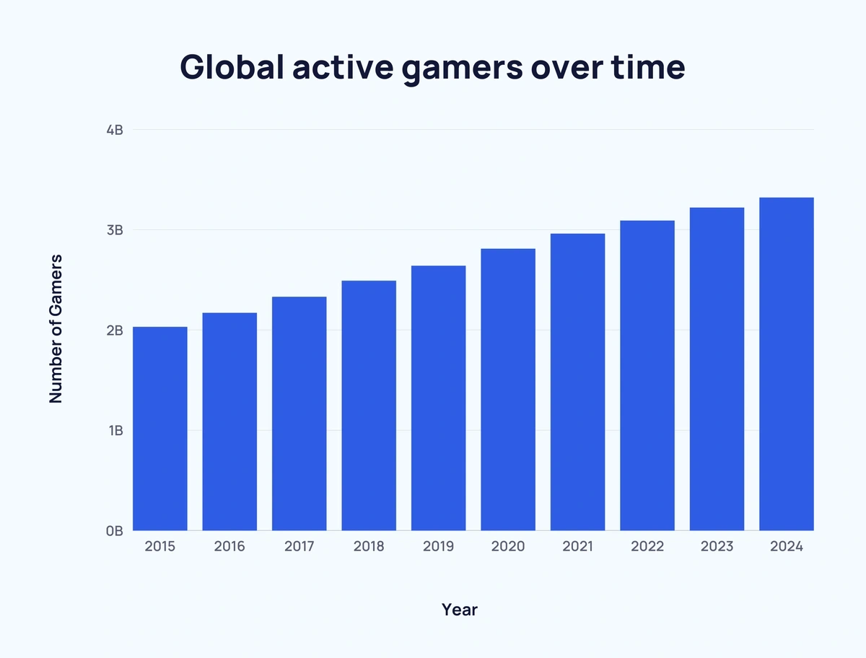
Games Are In Demand!
from Statista (2022)
from The World Economic Forum (2022)
from Exploding Topics (2025)

Slide 6


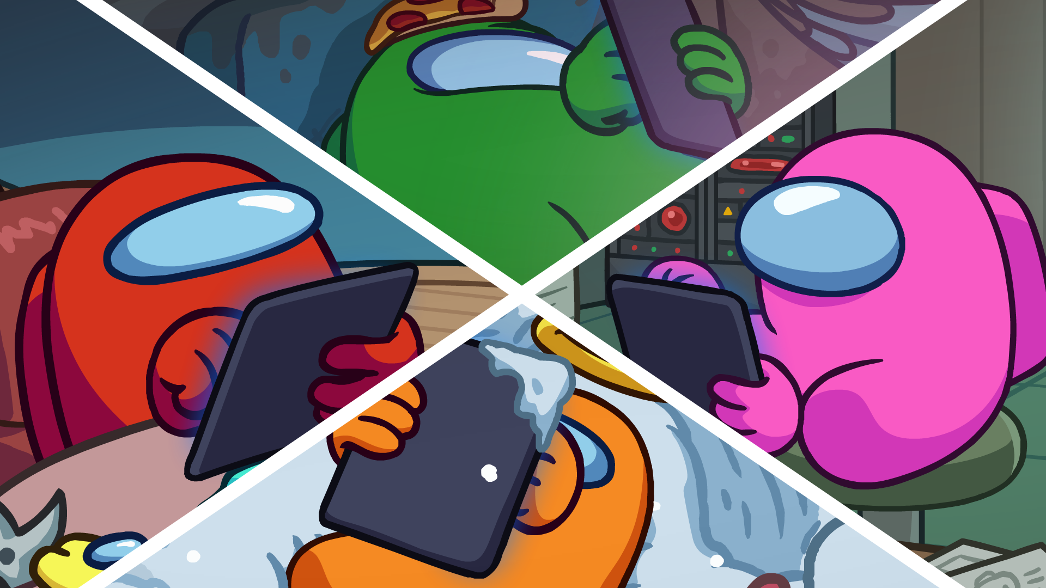


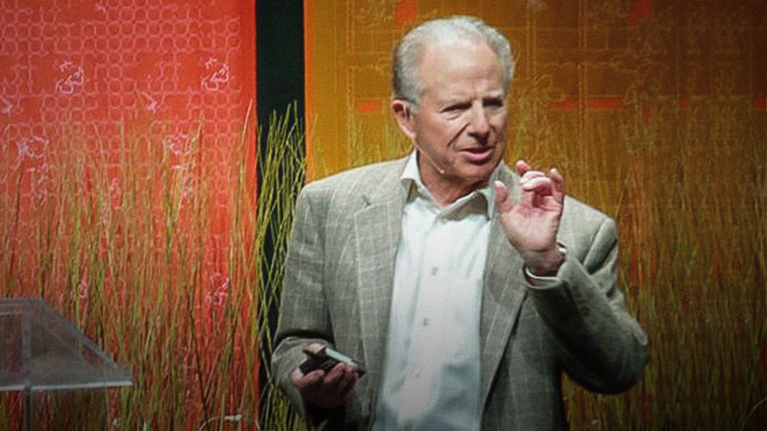
Games Are Fun!
Psychology of Play
(Stuart Brown)
“Opposite of play isn’t work– it’s depression”
“Violence is tied to an absence of play experiences”
Games as Storytelling
Games For Connection

Slide 7
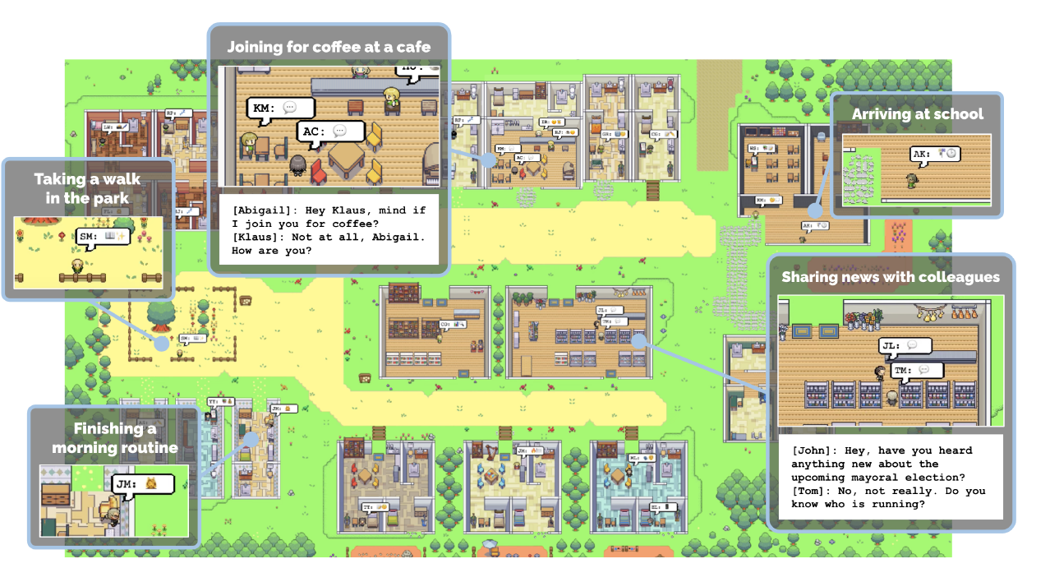
Games Inspire Innovation!
Graphics & Rendering (lots of math!)
Real-Time 3D Rendering
Ray Tracing & Global Illumination
CPU + GPU Innovation
Networking
Multiplayer games
Game Engines
Also used in automobile industry for prototyping cars!
Virtual Reality (VR) and Augmented Reality (AR)
Gamified Education
Research & Artificial Intelligence
Stanford Human-Centered Artificial Intelligence (HAI) Research: Making NPCs more human-like with AI
“Game designers have long tried to create NPCs that behave and interact like another human in the game. With generative agents, that now becomes a real possibility.” – Joon Sung Park
Read More Here!

Slide 8
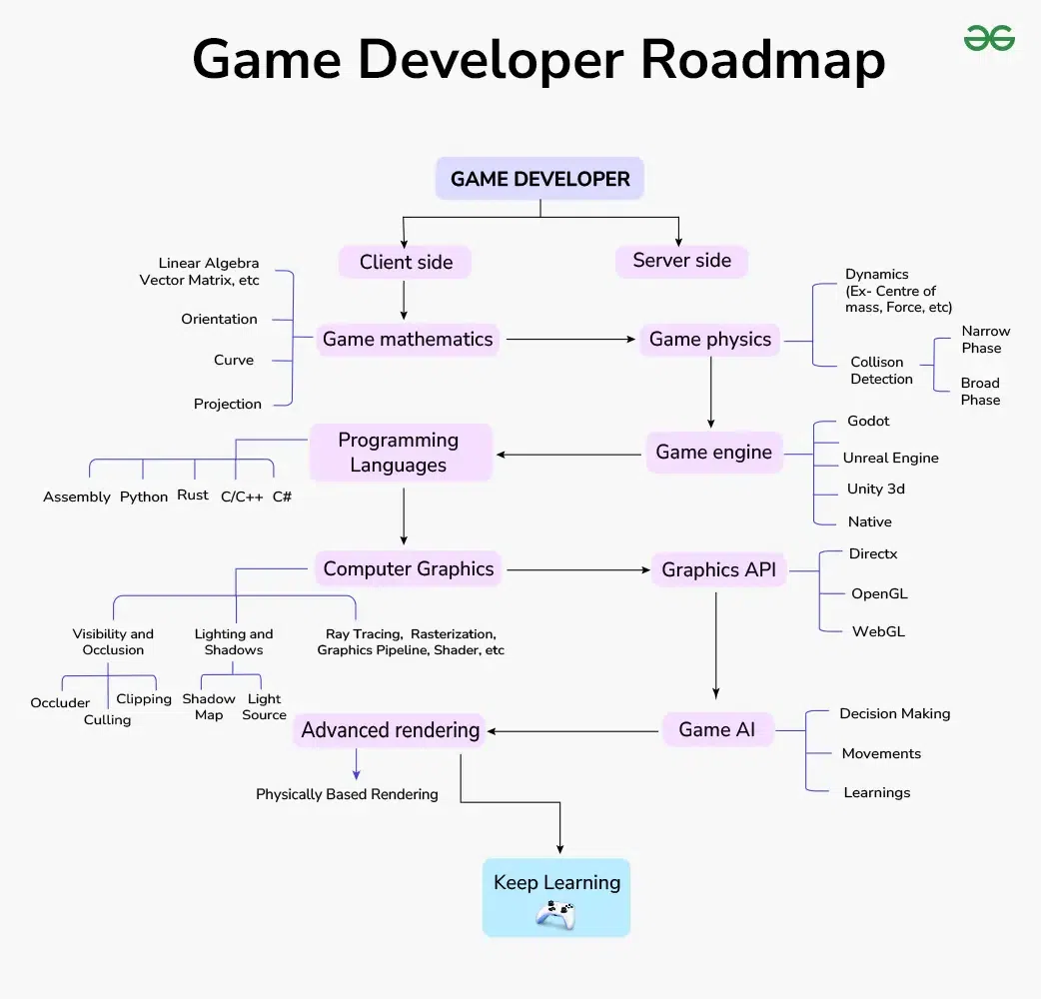
Making games can be a hard process…
But it doesn’t need to be perfect!
+ ART/GRAPHICS
+ MUSIC
+ SFXs
+ MARKETING
from Geeks For Geeks (2024)

Slide 9
We invited a guest speaker to…
🎤 Share his journey into game development
🛠️ Walk through his routine & process of building a large-scale game
🚀 Offer tips for beginners just getting started
🎨 Showcase his work– built with programming, hand-drawn art & animations, and lots of dedication
Q&A / Chat Norms
Please be respectful & show Watt lots of love!
Use the Q&A to submit your questions – we’ll set aside time at the end to answer some out loud
Use the chat respectfully – no spamming messages, stay kind, and on topic
No question is too small – all experience levels are welcome
Be patient – we may not get to every question, but we’ll try our best
Support each other – we’re here to learn and grow as a community

Slide 10
02.
Meet WattDesigns!
Youtuber and Creator of Isle Goblin

Slide 11
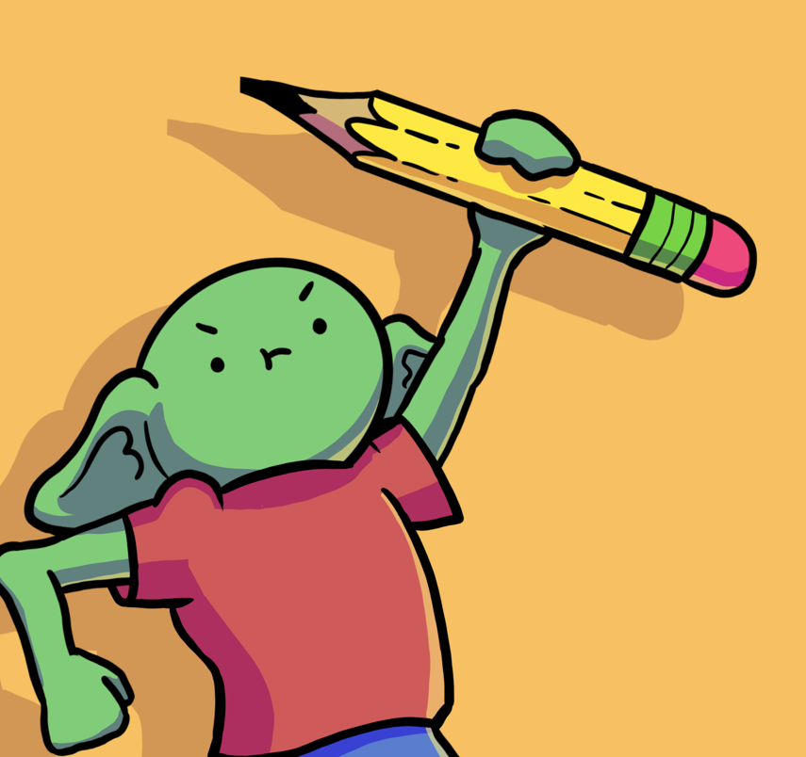


Meet Our Guest Speaker: Watt!
Part-Time Indie Game Developer & Youtuber
This is Hell (2022)
Isle Goblin (TBD)
Pixel Artist
Full-Time Electrical Engineer
@WattDesigns
@watt.designs

Slide 12
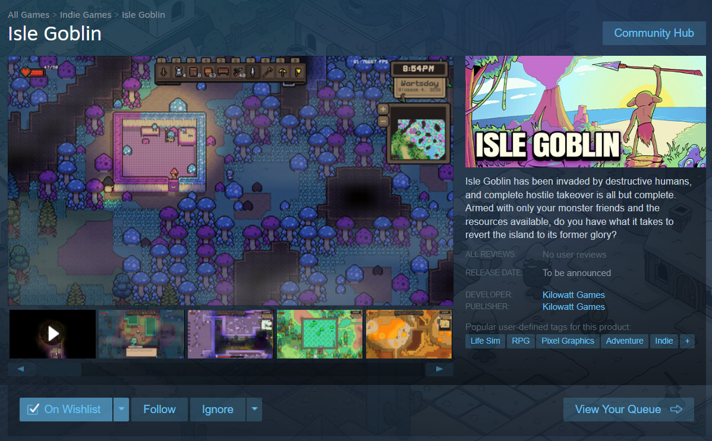

wishlist on Steam today!
Steam Link

Slide 13
03.
Closing Statement
What’s next?

Slide 14
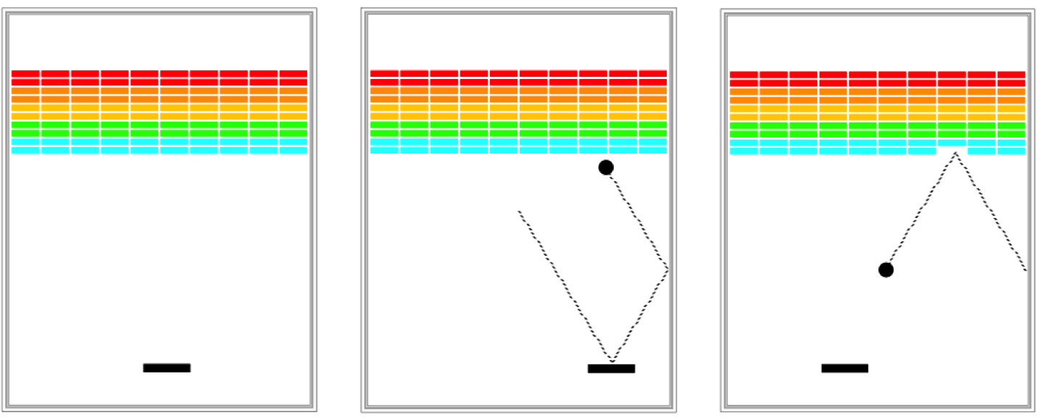
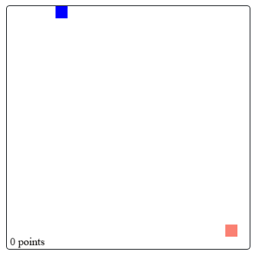
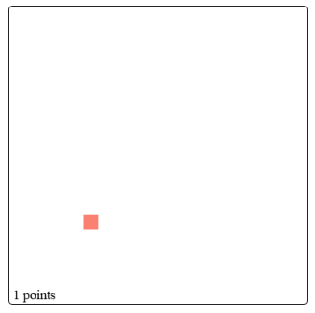
Making Games In Code In Place
Console Games: High Low (Week 4 Section) & Heads Up
Optional: Breakout
Optional: Baby Snake

Slide 15
Final Project?
Join Us in Workshop 2 to learn how to use the graphics library to make games!

Slide 16
THANK YOU, WATTDESIGNS!

